Slide 1
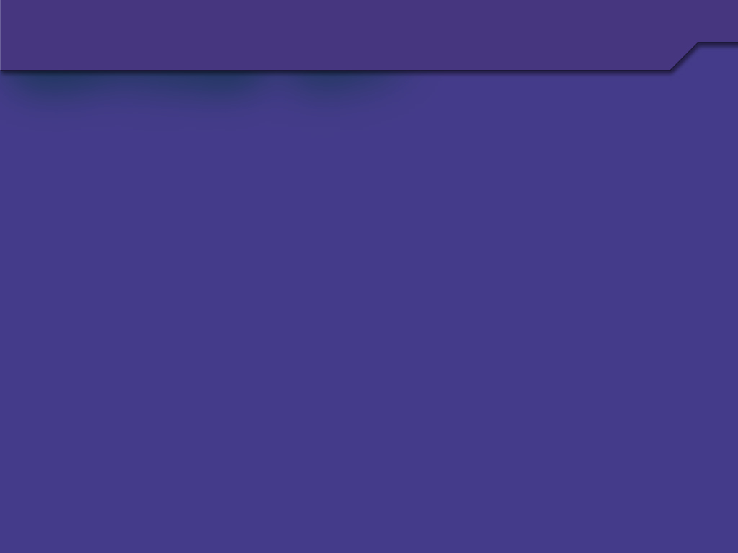
Data Structures
Lecture 29
Sohail Aslam

Slide 2
Complete Binary Tree
1
A
2
3
B
C
4
5
6
7
D
E
F
G
8
9
10
H
I
J
A
B
C
D
E
F
G
H
I
J
0
1
2
3
4
5
6
7
8
9
10
11
12
13
14
Question: why don’t we store all binary trees in arrays?
Why use pointers?
Notes:
End of lecture 28. Start of lecture 29.

Slide 3
The Heap ADT

Slide 4
Heap
A heap is a complete binary tree that conforms to the heap order.
The heap order property: in a (min) heap, for every node X, the key in the parent is smaller than (or equal to) the key in X.
Or, the parent node has key smaller than or equal to both of its children nodes.

Slide 5
Heap
13
21
16
24
31
19
68
65
26
32
This is a min heap

Slide 6
Heap
Not a heap: heap property violated
13

21
19

6
31
16
68
65
26
32

Slide 7
Heap
Analogously, we can define a max-heap, where the parent has a key larger than the its two children.
Thus the largest key would be in the root.

Slide 8
Inserting into a Heap
1
13
2
21
3
16
4
24
5
31
6
19
7
68
8
65
9
26
10
32
This is an existing heap
13
21
16
24
31
19
68
65
26
32
0
1
2
3
4
5
6
7
8
9
10
11
12
13
14

Slide 9
Inserting into a Heap
1
13
insert(14)
2
21
3
16
4
24
5
31
6
19
7
68
8
65
9
26
10
32
11
14
13
21
16
24
31
19
68
65
26
32
14
0
1
2
3
4
5
6
7
8
9
10
11
12
13
14

Slide 10
Inserting into a Heap
1
13
insert(14)
2
21
3
16
4
24
5
31
6
19
7
68
8
65
9
26
10
32
11
13
21
16
24
31
19
68
65
26
32
0
1
2
3
4
5
6
7
8
9
10
11
12
13
14

Slide 11
Inserting into a Heap
1
13
insert(14)
2
21
3
16
4
24
5
6
19
7
68
8
65
9
26
10
32
11
31
13
21
16
24
19
68
65
26
32
31
0
1
2
3
4
5
6
7
8
9
10
11
12
13
14

Slide 12
Inserting into a Heap
1
13
insert(14)
2
3
16
4
24
5
21
6
19
7
68
8
65
9
26
10
32
11
31
13
16
24
21
19
68
65
26
32
31
0
1
2
3
4
5
6
7
8
9
10
11
12
13
14

Slide 13
Inserting into a Heap
1
13
insert(14)
2
14
3
16
4
24
5
21
6
19
7
68
8
65
9
26
10
32
11
31
13
14
16
24
21
19
68
65
26
32
31
0
1
2
3
4
5
6
7
8
9
10
11
12
13
14

Slide 14
Inserting into a Heap
1
13
insert(14) with
exchange
2
21
3
16
4
24
5
31
6
19
7
68
8
65
9
26
10
32
11
14
13
21
16
24
31
19
68
65
26
32
14
0
1
2
3
4
5
6
7
8
9
10
11
12
13
14

Slide 15
Inserting into a Heap
1
13
insert(14) with
exchange
2
21
3
16
4
5
6
7
24
14
19
68
8
65
9
26
10
32
11
31
13
21
16
24
14
19
68
65
26
32
31
0
1
2
3
4
5
6
7
8
9
10
11
12
13
14

Slide 16
Inserting into a Heap
1
13
insert(14) with
exchange
2
14
3
16
4
24
5
21
6
19
7
68
8
65
9
26
10
32
11
31
13
14
16
24
21
19
68
65
26
32
31
0
1
2
3
4
5
6
7
8
9
10
11
12
13
14

Slide 17
Inserting into a Heap
1
13
insert(15) with
exchange
2
14
3
16
4
24
5
21
6
19
7
68
8
65
9
26
10
32
11
31
12
15
13
14
16
24
21
19
68
65
26
32
31
15
0
1
2
3
4
5
6
7
8
9
10
11
12
13
14
Notes:
Start of Lecture 30

Slide 18
Inserting into a Heap
1
13
insert(15) with
exchange
2
14
3
16
4
24
5
21
6
7
68
15
8
65
9
26
10
32
11
31
12
19
13
14
16
24
21
15
68
65
26
32
31
19
0
1
2
3
4
5
6
7
8
9
10
11
12
13
14

Slide 19
Inserting into a Heap
1
13
insert(15) with
exchange
2
14
3
15
4
5
6
7
24
21
16
68
8
65
9
26
10
32
11
31
12
19
13
14
15
24
21
16
68
65
26
32
31
19
0
1
2
3
4
5
6
7
8
9
10
11
12
13
14

Slide 20
Inserting into a Heap
1
13
insert(15) with
exchange
2
14
3
15
4
5
6
7
24
21
16
68
8
65
9
26
10
32
11
31
12
19
13
14
15
24
21
16
68
65
26
32
31
19
0
1
2
3
4
5
6
7
8
9
10
11
12
13
14
Notes:
End of lecture 29

